Slide 1
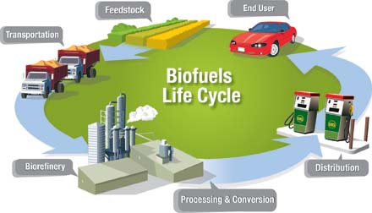
INTRODUCTION
BIOFUELS

Slide 2
BIOFUEL
Definition of Biofuels
Difference between hydrocarbons and biofuels
Creation of biofuels
Forms of biofuels
Notes:
Biofuels refers to combustibles generated from biomass
The main difference between hydrocarbons and biofuels is that latter is produced from biomass of plants that have ceased to exist in the recent past.
Biofuels are created directly from plant matter or indirectly from domestic, agricultural, industrial, or commercial wastes.
Biofuels can be in form of gaseous, liquid or solid form

Slide 3
TYPES OF BIOFUELS
Biogas fuel
Biodiesel
Bioethanol and Bio alcohols
Biohydrogen
Solid biomass
Notes:
Bigas fuel
Biogas is generated through anaerobic digestion or fermentation of organic substances.
Biodiesel
Biodiesel is produced through transesterification process. It involves separation of fatty acids from glycerol followed by subsequent glycerol replacement by an alcohol group to form a methyl ester.
Bioethanol and Bio alcohols
The primary materials used in the production of bioethanol is starch products or sugars.
Biohydrogen
It refers to the biological production of hydrogen gas. Hydrogen is a clean source of energy that can be produced in fermentation processes of specific biomasses.
Solid biomass
Solid biomasses include dried manure, wood, energy dense non-food crops, sawdust, agricultural wastes, grass trimmings, charcoal, and domestic refuse.

Slide 4
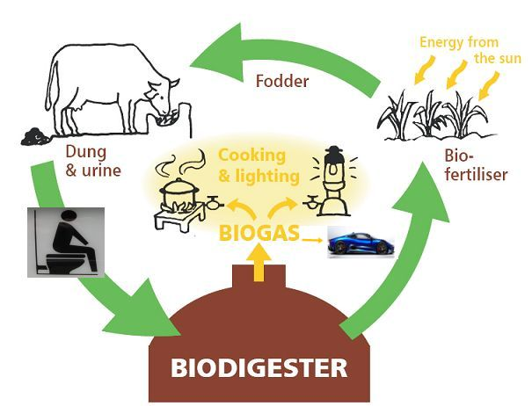
Biogas fuel

Slide 5
BIOGAS FUEL
How it is generated
What is used in the process
What is used to control the process
Notes:
Biogas is generated through anaerobic digestion or fermentation of organic substances.
special naturally occurring bacteria is used in the process to produce carbon dioxide and methane in an oxygen deficient environment, that is, anaerobic.
The process is controlled through application of heat to achieve optimal conditions based on material inputs.

Slide 6
BIODIESEL
The process used to generate the fuel
Elements employed in the process
Notes:
Biodiesel is produced through transesterification process
Just like biogas production, additives such as neutralizing acids, heat, and catalysts are employed in the transesterification process to create an optimal environment.

Slide 7
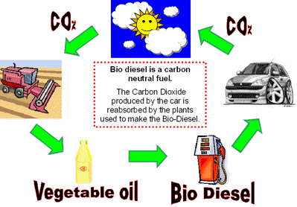
Biodiesel

Slide 8
BIOETHANOL AND BIO ALCOHOLS
Production
Materials used
Popularity of the Biofuel
Notes:
The primary materials used in the production of bioethanol is starch products or sugars.
The materials involved in production of Bioethanol and Bio alcohols include
Such substances include corn, sugar beets, cereals, and other plant materials that have a high content of sugar
Unlike biogas and biodiesel, production of ethanol is a conventional process in many countries.

Slide 9
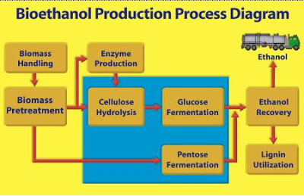
Bioethanol and bio alcoholics

Slide 10
BIOHYDROGEN
Definition
Process involved in production
The initial step
Notes:
It refers to the biological production of hydrogen gas
Hydrogen is a clean source of energy that can be produced in fermentation processes of specific biomasses.
In the initial step, glucose is converted to carbon dioxide and either acetic acid or methanoate depending on the reaction conditions.

Slide 11
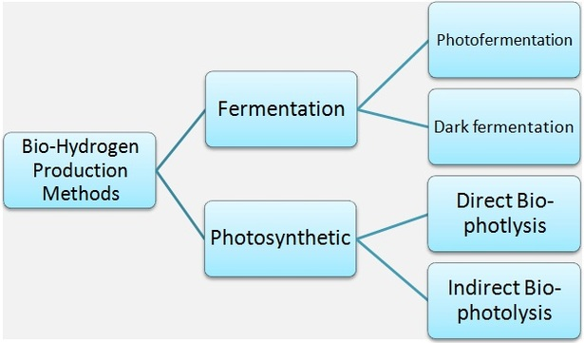
Biohydrogen

Slide 12
SOLID BIOMASS
Components
The process involved
Advantages
Disadvantage
Notes:
Solid biomasses include dried manure, wood, energy dense non-food crops, sawdust, agricultural wastes, grass trimmings, charcoal, and domestic refuse.
The process involved in production of solid biomass is known as densification process
The advantage is that Fuel from solid biomass is advantageous because it is a waste-product, byproduct or residue of other human-made processes such as forestry, farming, crop or animal husbandry.
Therefore, there is no competition for resources between food and fuel production.
The main disadvantage is that this type of fuel when burned emit significant amounts of air pollutants such as polycyclic aromatic compounds (chlorophenols and dioxins) and particulates.

Slide 13
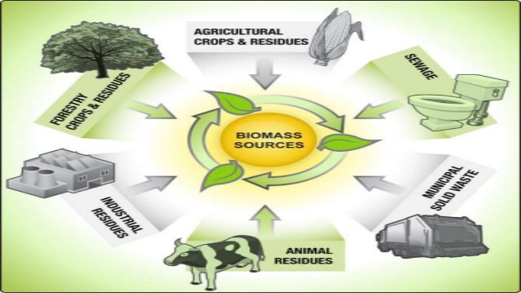
Solid Biomass

